Slide 1
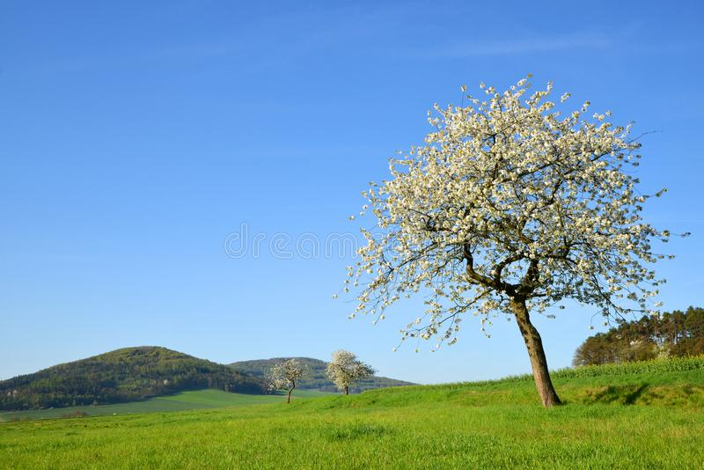
Spring Up Collect Data of blooming Trees in your Region and monitor the impact of Climatechange in your backyard

Slide 2
The challenge is: To get as many pictures of blooming trees in the region as possible
So we can process the collected data and show impact of Climatechange near your home

Slide 3

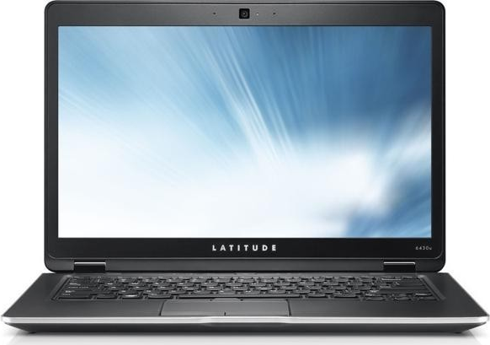
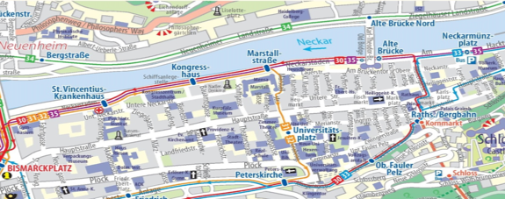


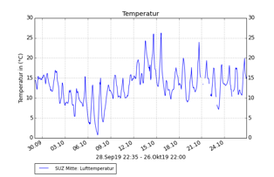
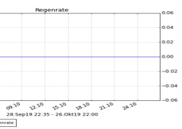



We provide a fun
game App
to search the blooming trees
(Like a treasure hunt)
We establish a Homepage to Monitor Change of blooming Trees in season and years

Slide 4
How does such a “blooming Tree hunt” look like
show of Tree Map Picture
Why should people make pictures of that blooming tree and send data?
Show Picture of Tree Map and reward,
→ Name of First in Year

Slide 5
How do we get people to search and find blooming Trees in der region
Demonstration of Tree Blooming Prediction

Slide 6











Who would be interested in that Blooming Tree search/hunting
School classes
Acquisition via educational program
(Theresia Bauer)
Gardner
Acquisition via tree nursery shops
Walk the dog people
Acquisition via Dog Food Stores

Slide 7
What is so unique about it?
Demonstration of :
>> App – Homepage – Data processing
>> Award – learning experience -
awareness of Climate Change

Slide 8
What else is out there Compeditors – Tree apps, SWR …
Nice Stuff but..
Our Product is way better
Can do more and is legal !
>> App – Homepage – Data processing
>> Award – learning experience -
awareness of Climate Change

Slide 9
Proof of Concept
Demonstration of :
Short run: 30´ Sek.
>> The hole Thing on one (Fake) examble

Slide 10
Thank you
Your questions please

Slide 11



Costs and Finance
To implement the App , Homepage and Dataprocess
Marketing, social media etc. 600.000,-€
To Run the system aprox. 36.000,-€ p.a.
Companies spend many for
“Greenwashing” Events e.g. 4.000,-€ day

Slide 12




Legal aspect
Same AGB than Instagram, Facebook , Whats App ..
People volounterily share the data

Slide 13







Who else would be interested in that Blooming Tree search/hunting
Tourists
Acquisition via Tourist Office
Students
Acquisition via University
Senior citizens
Acquisition via

